Slide 1
Type I & II Error
Type I: Rejecting the null hypothesis when it is true
Type II: Accepting the null when it is false
[Null Hypothesis is a statement about Population]
Type I error is called Level of Significance and represented by α
No error situations:
Accepting the null hypothesis when it true
Rejecting the null hypothesis when it is false.

Slide 2
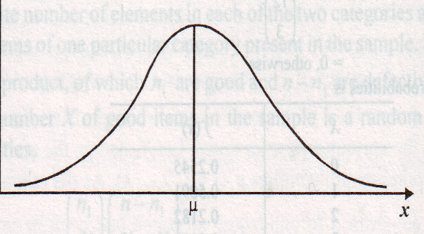
Type I Error
Alpha, Level of Significance, α, 1-tail
α = 10%
α = 5%
α = 1%
0.99
1-α = Confidence Level
Less α, higher CL
More α, lower CL
0.95
0.01
0.90
0.05
0.10

Slide 3
Type I Error
Alpha, Level of Significance, α, 2-tail
α = 10%
α = 5%
α = 1%
0.99
1-α = Confidence Level
1-tail and 2-tail gives same CL.
However, 2-tail reduces the area of rejection by half (as compared to 1-tail)
0.005
0.005
0.95
0.025
0.025
0.90
0.05
0.05

Slide 4
Hypothesis Testing First import files: cs2m, grades, wmps, wmpl, mws, mwl, kw Next: install.packages(“psych”)

Slide 5
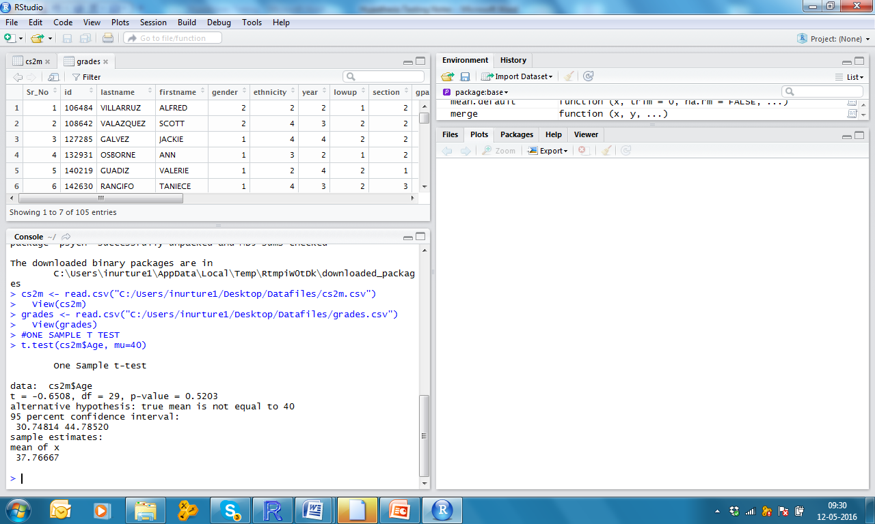
One Sample t test File: cs2m.csv [Ho: Mean Age = 40]

Slide 6
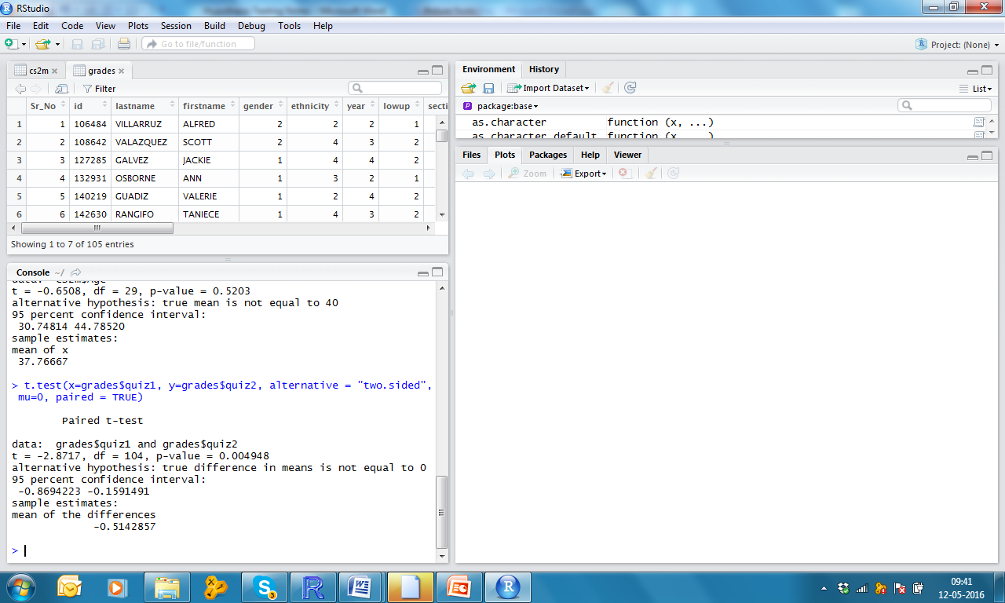
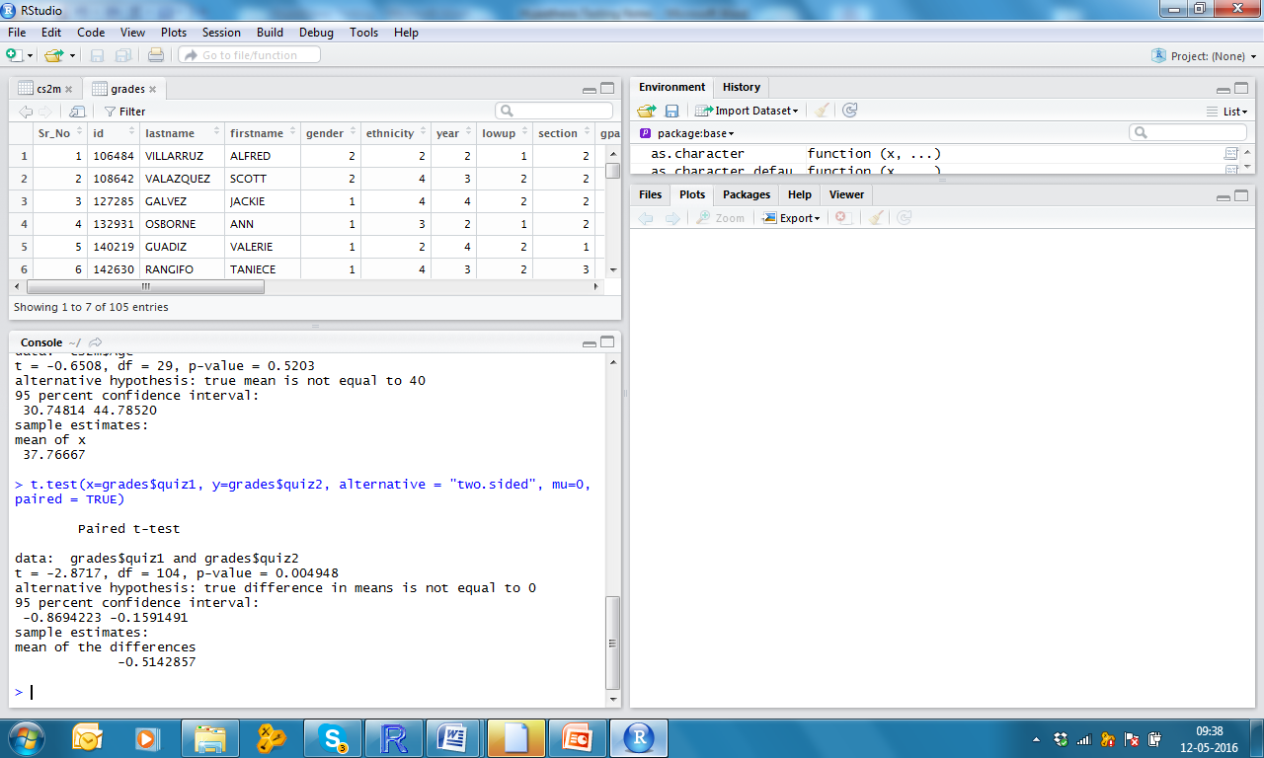

Paired Sample t test File: grades.csv [Ho: Mean Quiz1 –Mean Quiz 2 = 0]
Q1 = 7.47
Q2 = 7.98

Slide 7
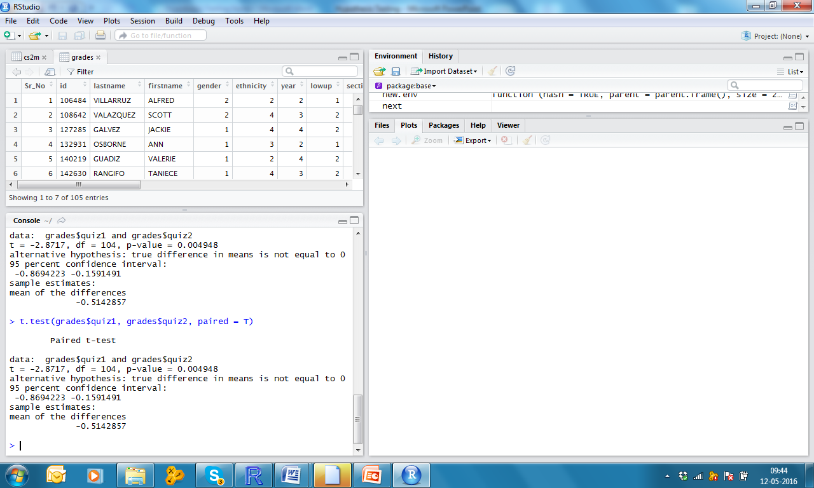
Paired Sample t test File: grades.csv [Ho: Mean Quiz1 –Mean Quiz 2 = 0]

Slide 8
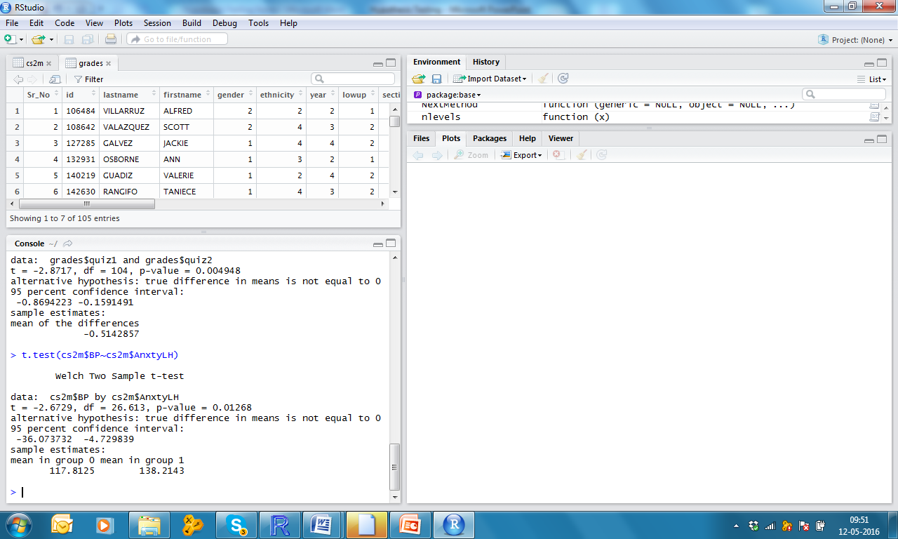
Independent Samples t test {assuming unequal variance} File: cs2m.csv [Ho: Mean BP across Anxiety Levels are same]

Slide 9

Independent Samples t test {assuming equal variance} File: cs2m.csv [Ho: Mean BP across Anxiety Levels are same]
gpa, ethnicity, 5
45
45.5

Slide 10
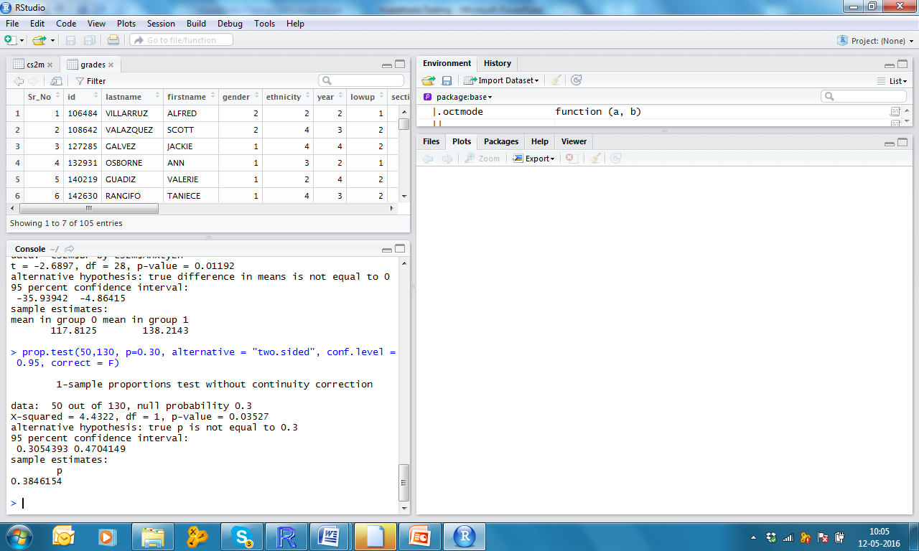
One Sample Proportion Test A researcher believes that market size of diesel cars is 30%. For testing his belief, he had taken a sample of 130 cars and found 50 diesel cars. Ho: p=0.30

Slide 11
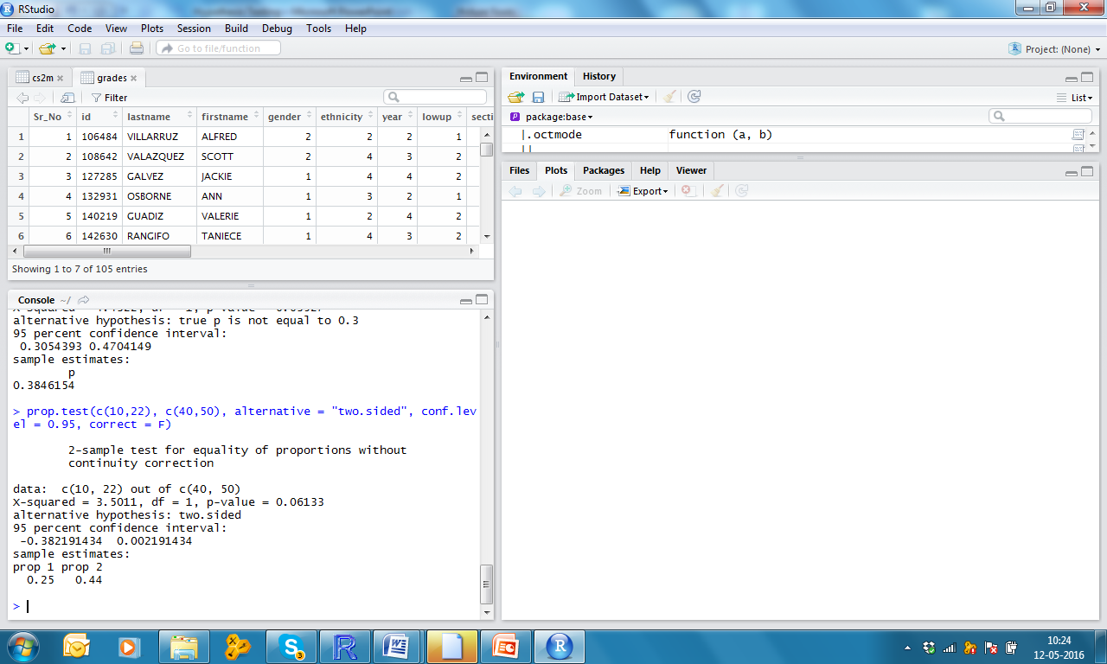
Two Samples Proportion Test A researcher has found 10 stressed faculties out of a sample of 40 at Christ college and 22 out of 50 at St. John. Ho: p1-p2 = 0

Slide 12
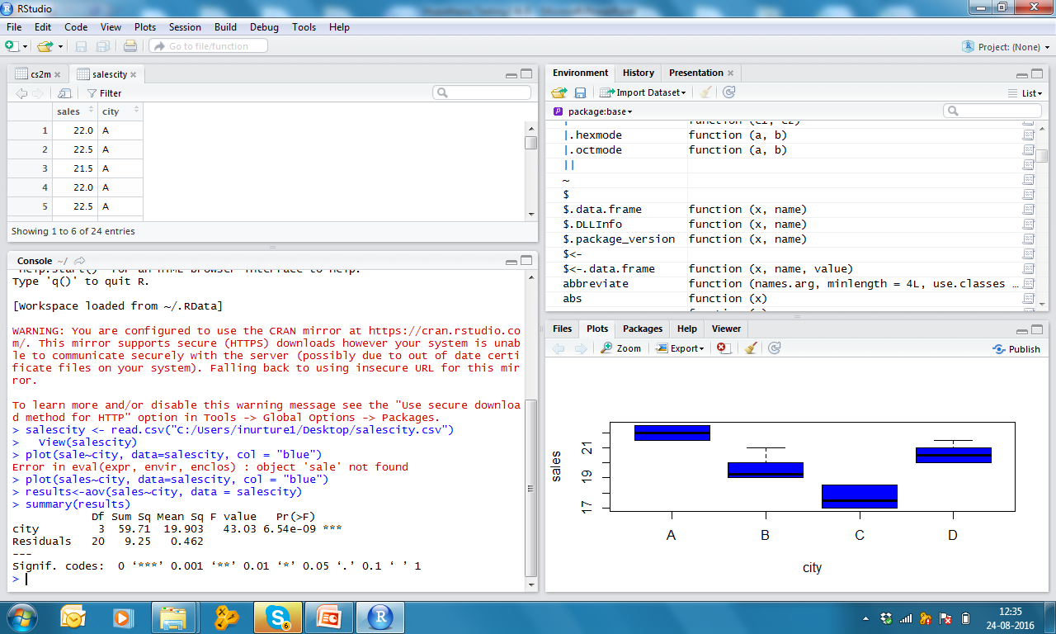
One Way ANOVA File: salescity.csv

Slide 13
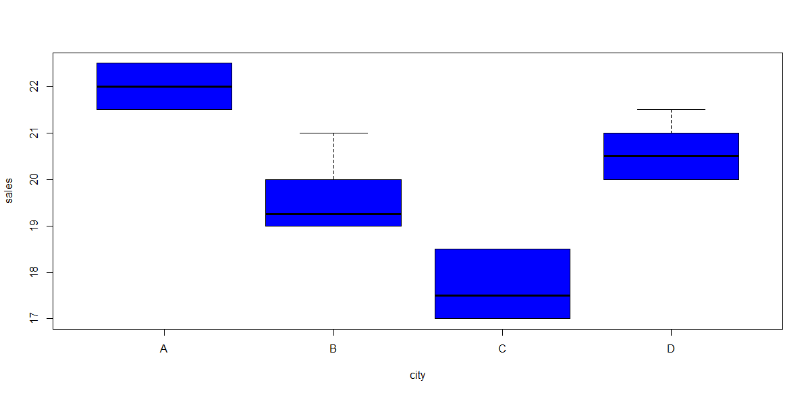
Plot Box plots: Sales vs Cities

Slide 14


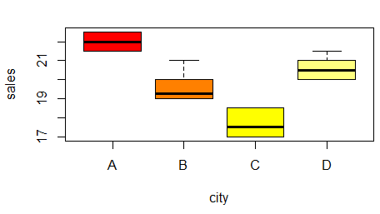

Slide 15
ANOVA

Slide 16
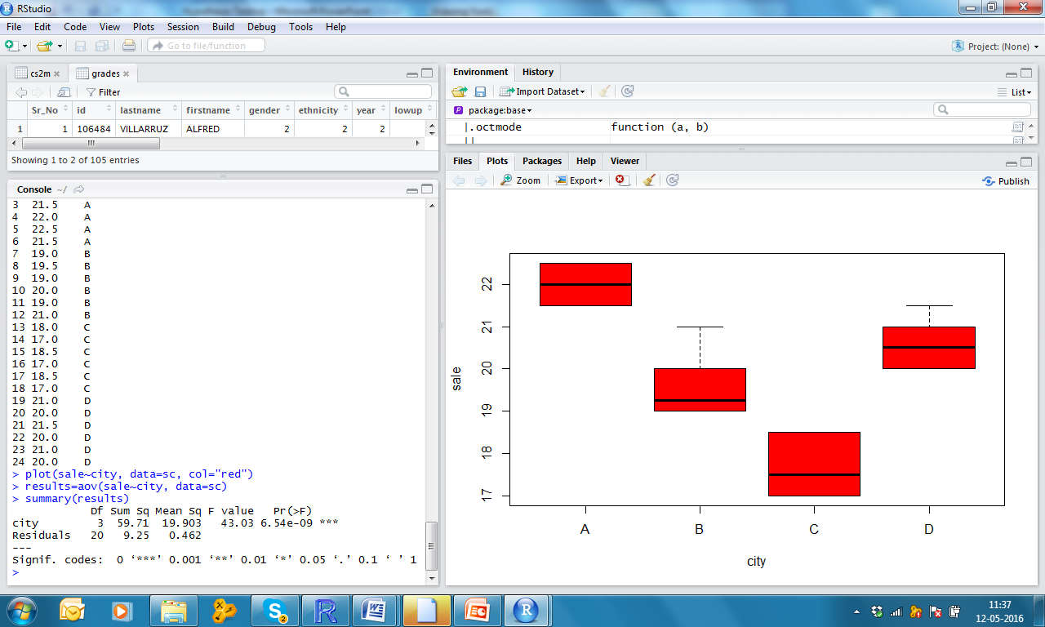

Slide 17
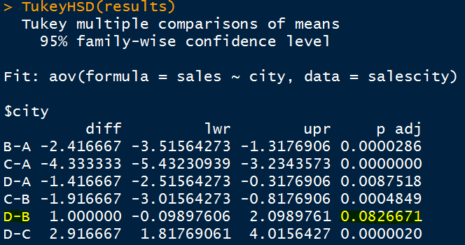
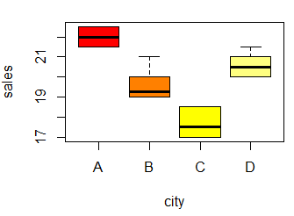
Ho:
The mean difference across
Groups D &B is insignificant
Post Hoc Comparison

Slide 18
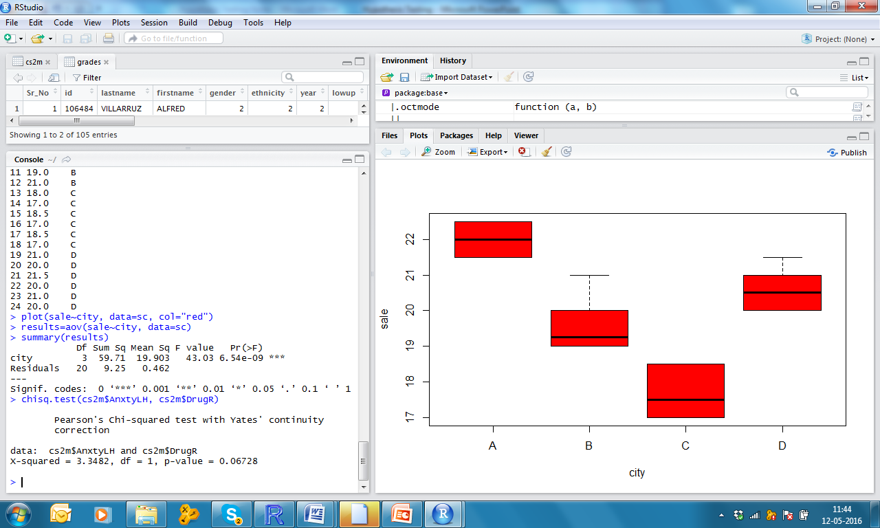
Chi-Square Test File: cs2m [Ho: There is no association between Anxiety and Drug Reaction
Both are continuous: a) correlation, paired , indep (one cont, one categ with 2 levels only)
If one continuous & one categ with more than 2 levels = One Way ANOVA
If both are categorical : Association between 2 categ variables ➔ Chi-Square test

Slide 19
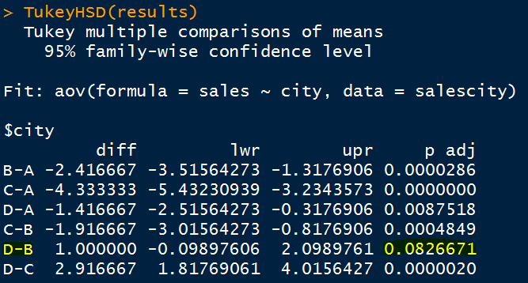
Post Hoc comparison
Ho:
The mean difference across groups
D & B is insignificant

Slide 20
Chi-Square Test File: cs2m [Ho: There is no association between Anxiety and Drug Reaction

Slide 21
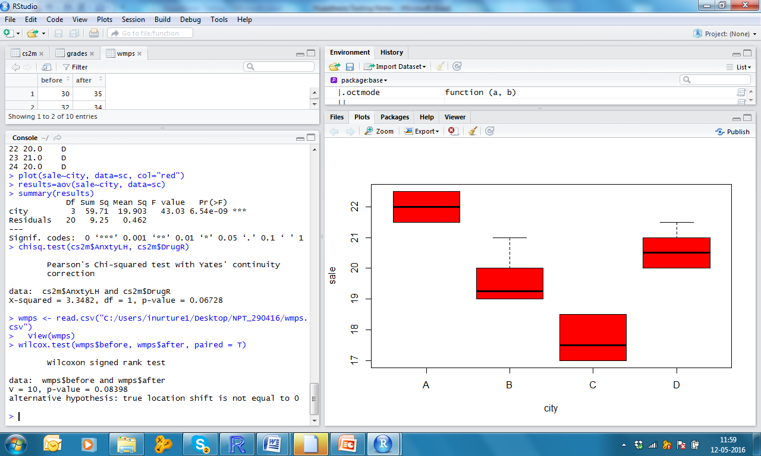
Wilcoxon Matched Paired (Small Sample) File: wmps [Ho: Md = 0]

Slide 22
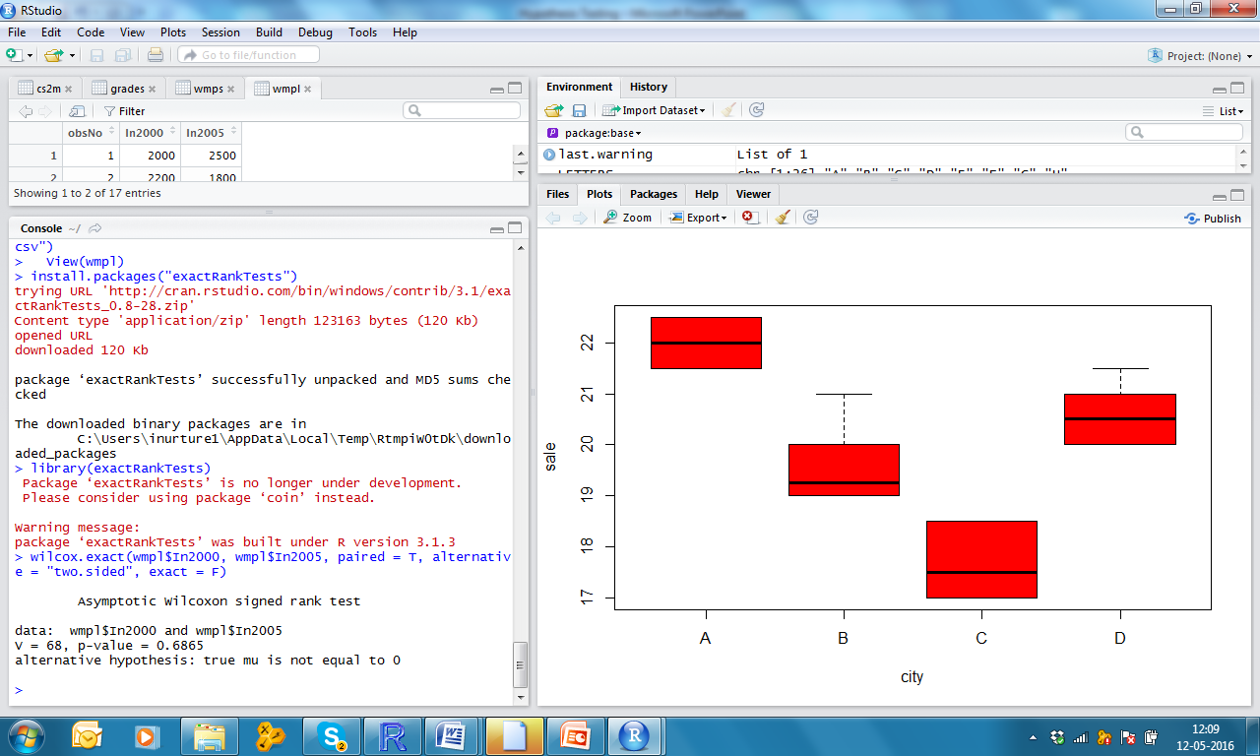
Wilcoxon Matched Paired (Large Sample) File: wmpl [Ho: Md = 0] First install.packages(“exactRankTests”) Type library(exactRankTests)

Slide 23

Mann-Whitney (Small Sample) File: mws [Ho: Md = 0]

Slide 24
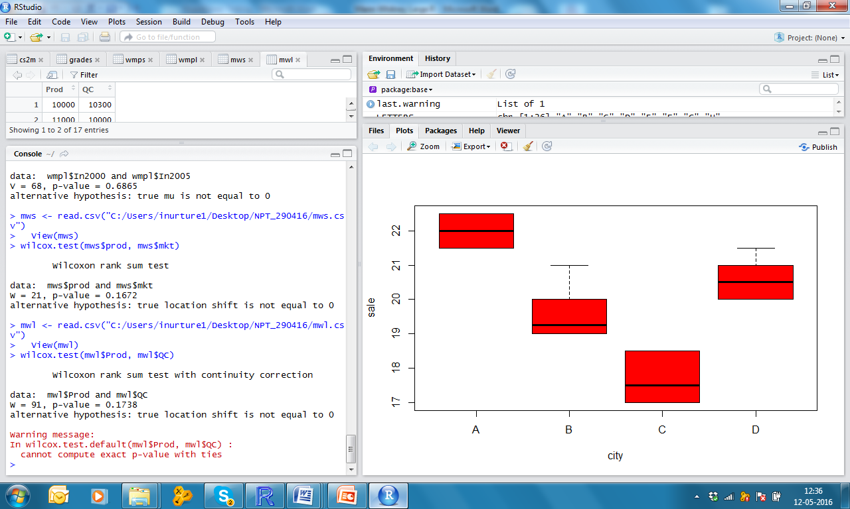
Mann-Whitney (Large Sample) File: mwl [Ho: Md = 0]

Slide 25
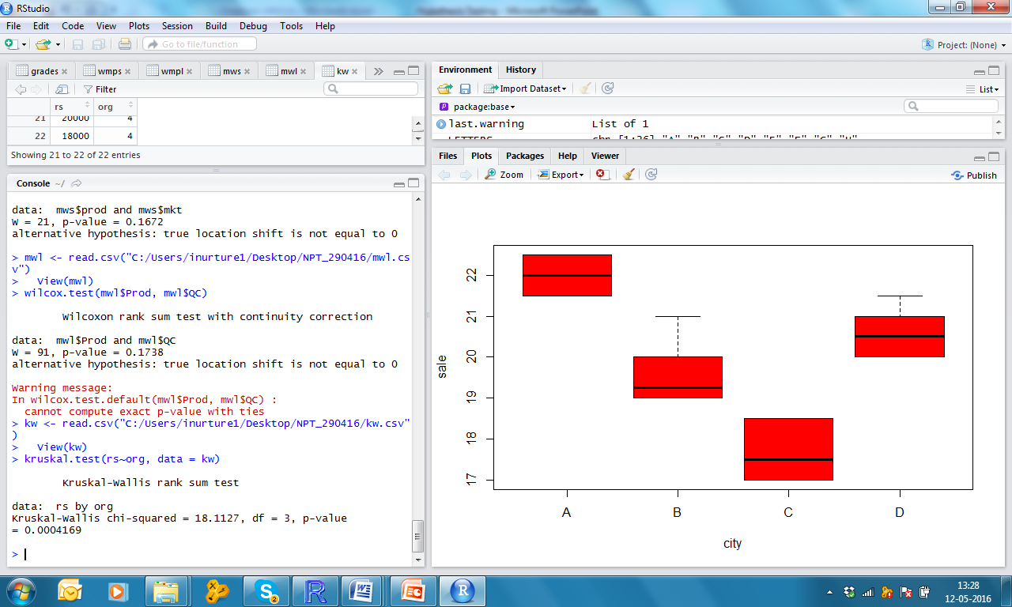
Kruskal Wallis File: kw

Slide 26
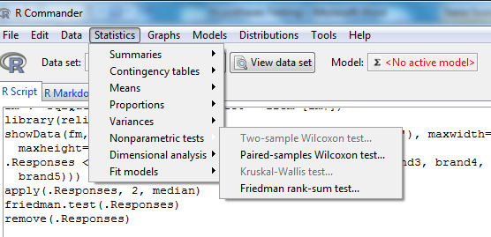
Friedman ANOVA File: fm.xlsx

Slide 27
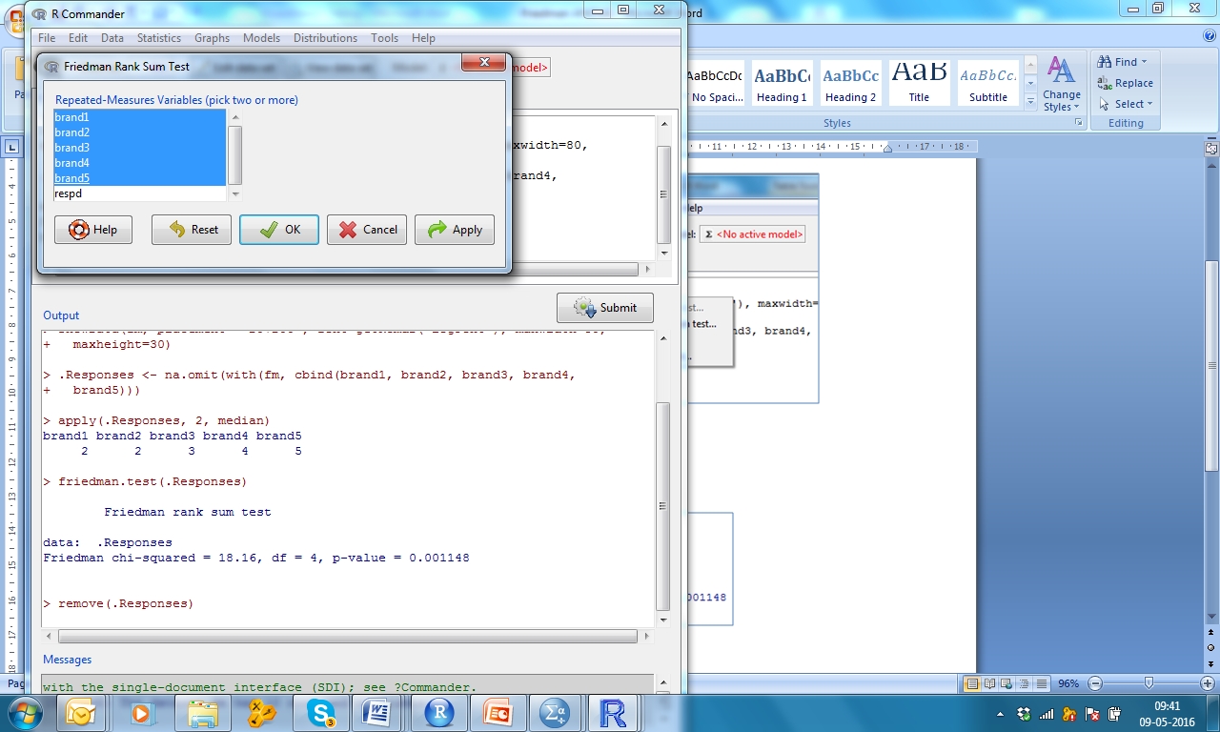
Friedman ANOVA File: fm.xlsx

Slide 28
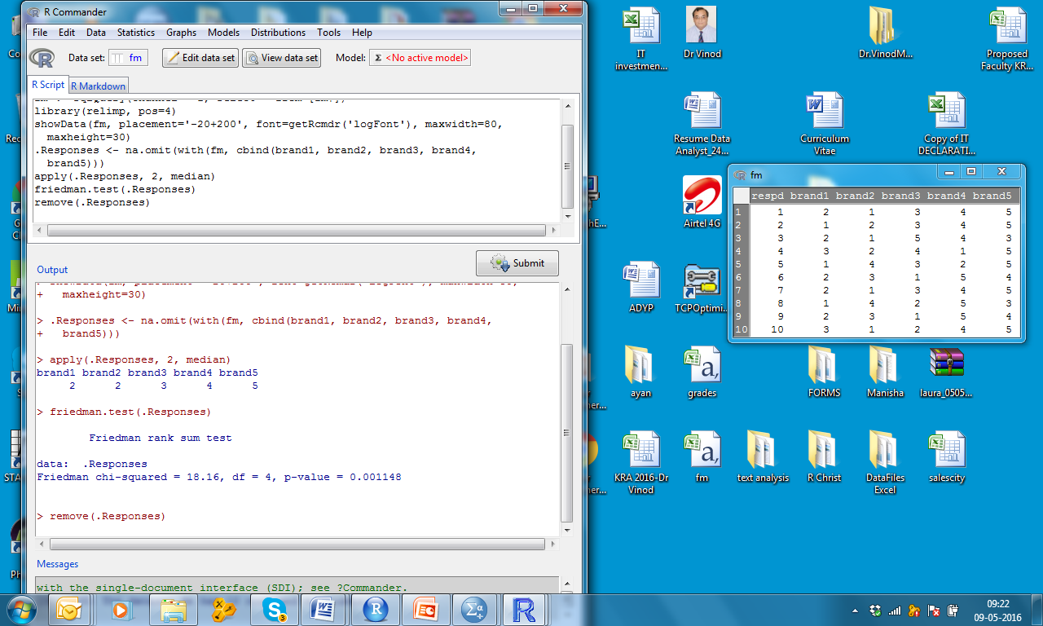
Friedman ANOVA File: fm.xlsx

